Slide 1
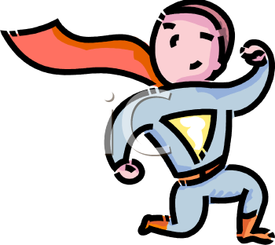
Hero Hall of Fame

Slide 2
What do you think a hero is?

Slide 3
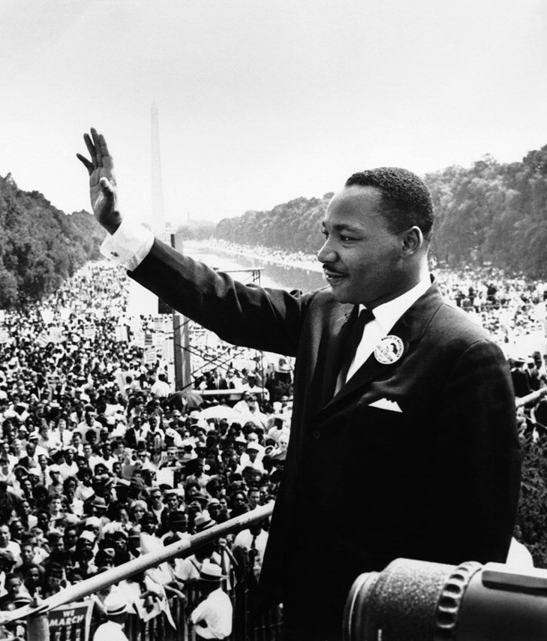
Many times, our heroes those who speak for others.

Slide 4
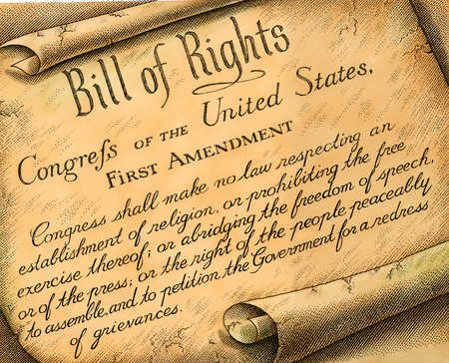
They use their First Amendment rights to bring about changes that are needed. They are heroes of the First Amendment!

Slide 5
Let’s recall what the 1st Amendment says… “Congress shall make no law …abridging the freedom of speech, or of the press; or the right of the people peaceably to assemble…”

Slide 6
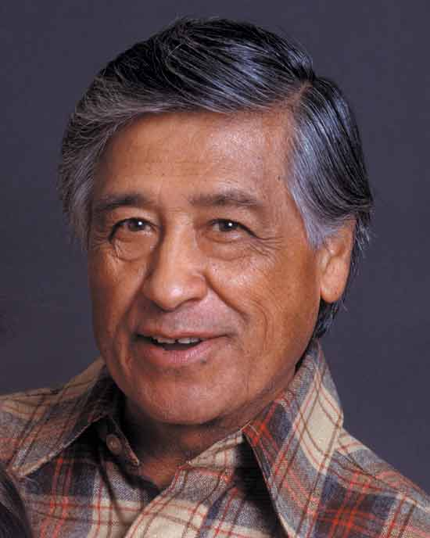
What can we learn from these pictures about this hero of the First Amendment?

Slide 7
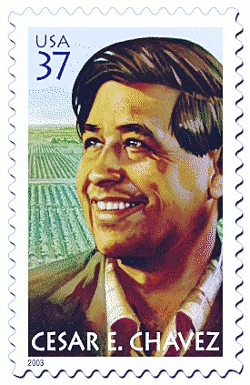

Slide 8
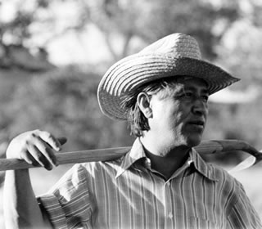

Slide 9
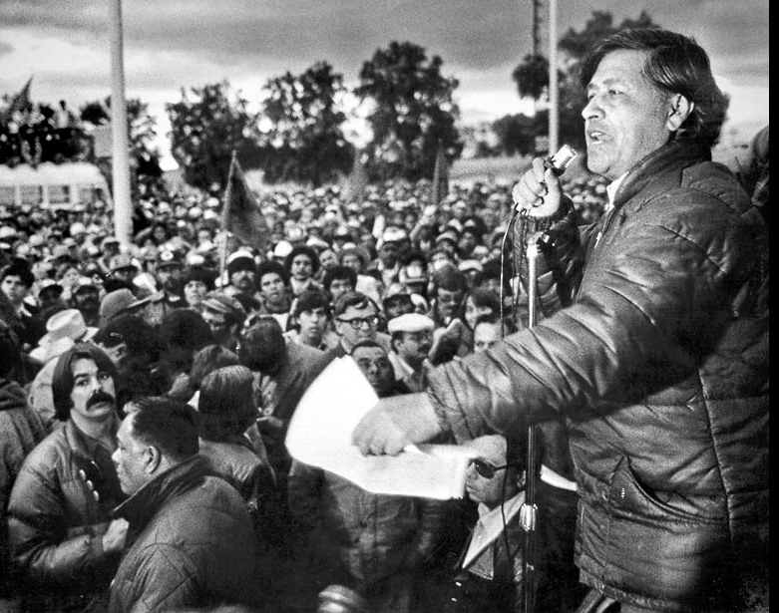

Slide 10
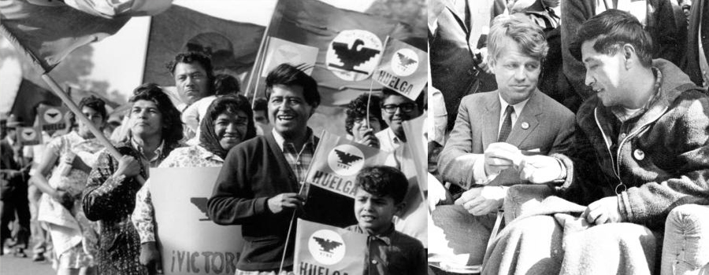

Slide 11
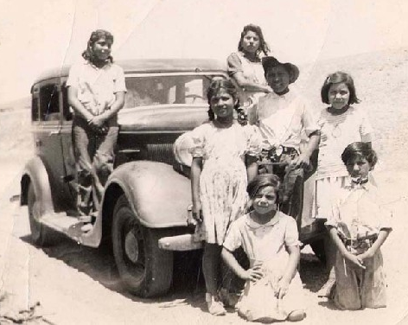
Cesar Chavez grew up in a big family.

Slide 12
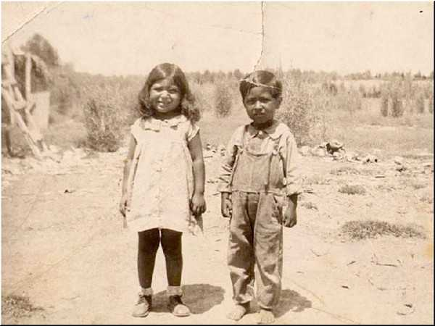
They were workers who moved from farm to farm in the United States.

Slide 13
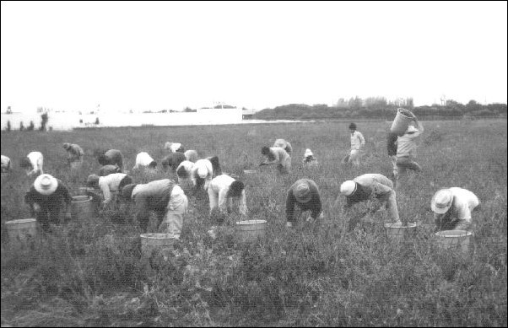
When it was time to harvest a crop, farmers needed help.

Slide 14
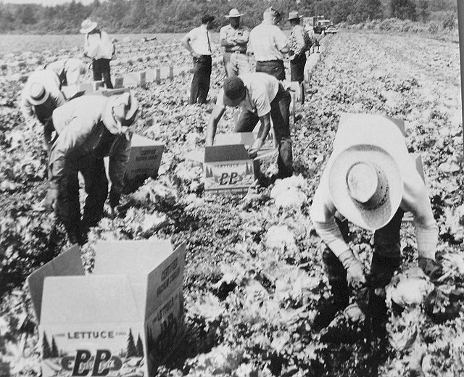
So Cesar, his family, and many more families helped farmers at harvest time.

Slide 15
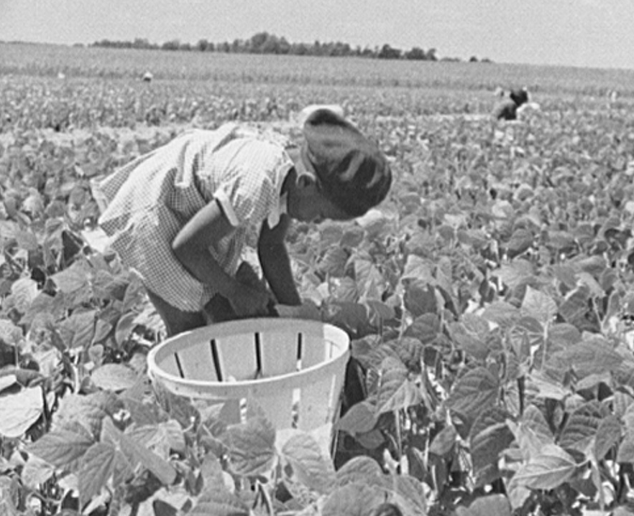
They picked fruit and vegetables on big farms. But farm workers were not paid very much money.

Slide 16
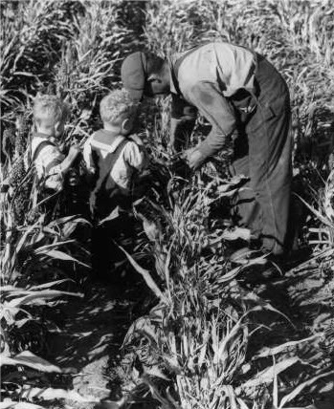
They also worked very long days. And they did not have very good places to live.

Slide 17
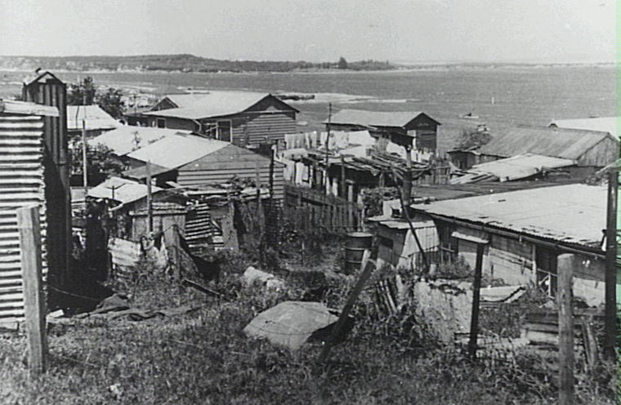
They had to near the fields. Many homes did not have water or electricity.

Slide 18
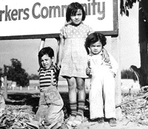
But Cesar was told to respect and help other people. His mother told him, “You always have to help the needy, and God will help you.”

Slide 19
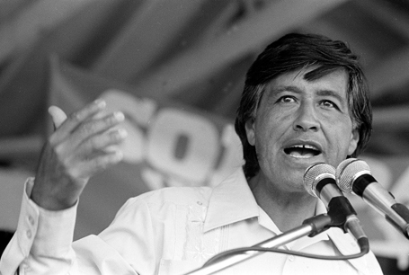
When Cesar grew up, he wanted to help his family and the other migrant workers. A migrant is someone who moves from place to place to find work.

Slide 20
In our country, we have rights. One of those rights is to say what we want to say.

Slide 21
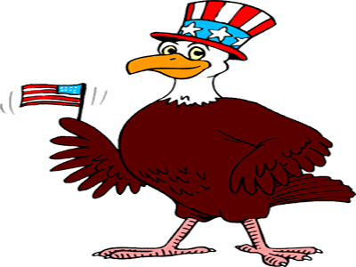
Another right is to get together with our friends. Other people get together in churches. These are different kinds of groups. Many groups get together (assemble) to share ideas.

Slide 22
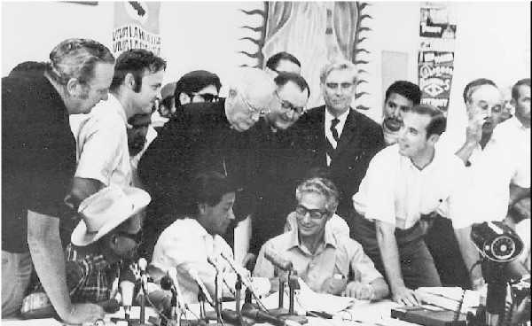
Some people get together in a group so they can talk about things they care about.

Slide 23
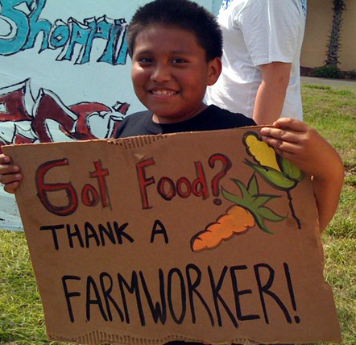
Some groups meet together so they can change things. Cesar helped migrant workers get together so they could change things.

Slide 24
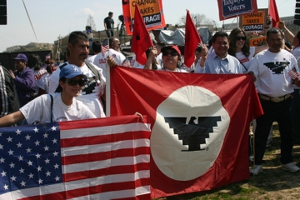
Cesar called their group the United Farm Workers of America.

Slide 25
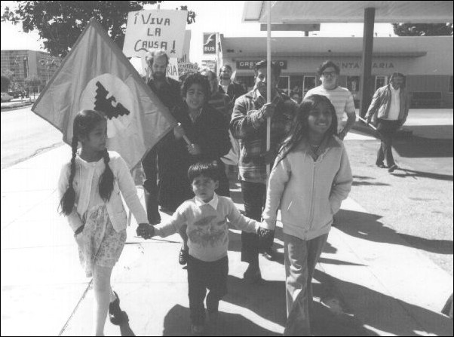
The United Farm Workers worked to tell our leaders what needed to be changed.

Slide 26
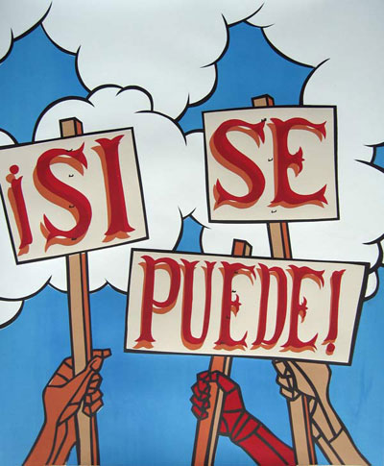
They wanted fair treatment for their jobs. They had a slogan. (A slogan is a short sentence that others can remember…)

Slide 27
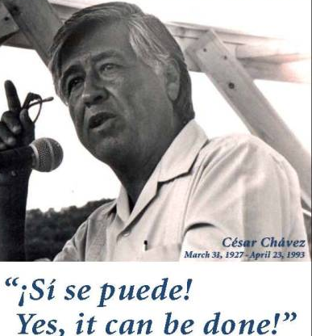
Their slogan was “Si se peude.” This is Spanish. What do you think it means?

Slide 28
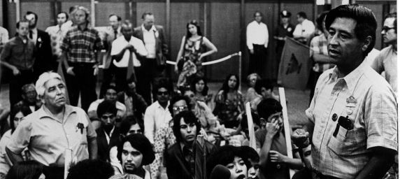
Cesar and the workers talked to leaders in our government. People listened. New laws were passed. The laws made sure that workers were treated fairly.

Slide 29
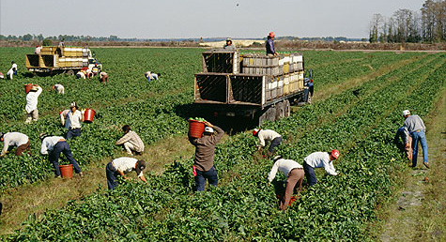
Because Cesar was a good leader of the migrant farm workers, they have a better life today.

Slide 30
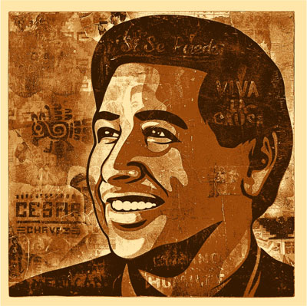
Cesar Chavez said,
We can not think of ourselves and forget our community. People can work together to solve their own problems.

Slide 31
Why is Cesar Chavez a First Amendment hero?

Slide 32
What rights did Cesar Chavez use to bring change for others? “Congress shall make no law …abridging the freedom of speech, or of the press; or the right of the people peaceably to assemble…”

