Slide 1
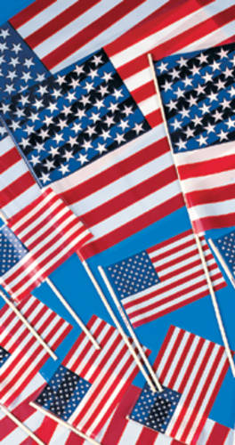
Our Flag, Patriotism, and the First Amendment

Slide 2
Facts: On Patriot Day last year, several students wanted to show their patriotism by dressing up. Many children in the elementary school wore clothing with flag symbols on it. When they arrived at school, the principal did not like what she saw. “The flag clothing was disrespectful,” she said. “And it is against the national flag code.” So, she sent the students home that day.

Slide 3
The children and their parents were sad about the principal’s decision. They thought it was unfair. After all, the flag clothing was just a way for students to show their patriotism. Didn’t students have First Amendment rights? Isn’t messages sent by our choice of clothing a kind of speech? Or should the flag code be obeyed? Let’s look at the evidence: the children’s clothing.

Slide 4
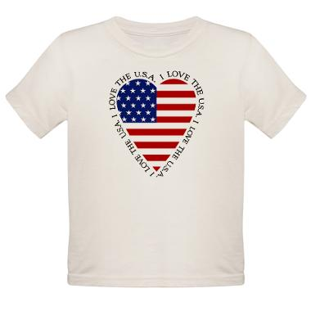

Slide 5
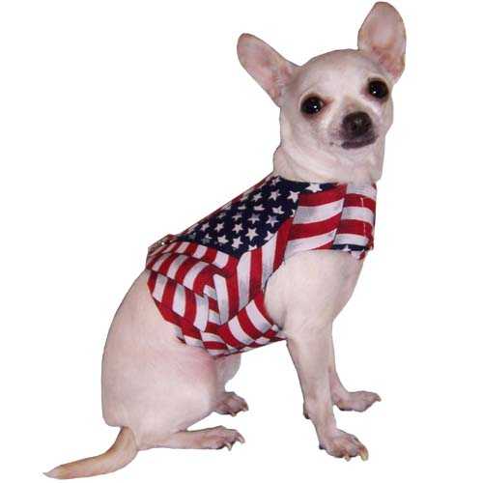

Slide 6
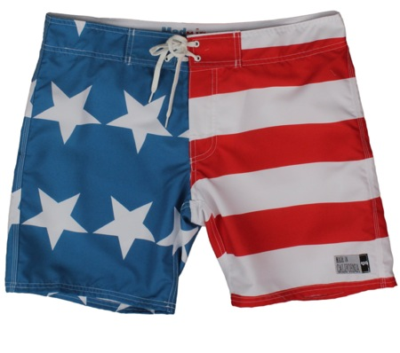

Slide 8
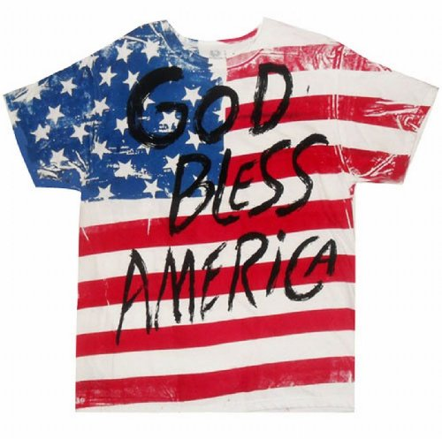

Slide 11
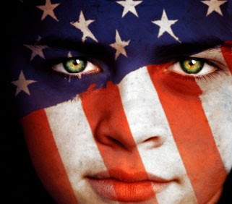

Slide 12
Let’s ask the Supreme Court!

